Slide 1

Predicting the VIX with stock headline sentiments
Improvements over standard time-series models
Mike Daniel
Springboard Data Science Career Track Special thanks to Kevin Ding
This Photo by Unknown Author is licensed under CC BY-NC-ND

Slide 2

Can improvements be made in the time series forecasting of the VIX by adding in sentiment analysis of financial headlines?
Many attempts have been made to predict the “fear index” .
Many studies focus on a variety of financial indicators to improve performance.
These models typically are reactive to changes in the VIX but have a slow recovery time to changes.
Can the sentiment of headlines about stocks be used instead to create a model which can proactively predict the spikes.

Slide 3

The Data
The data was merged from two data sets.
The headlines are from “Daily Financial News for 6000+ Stocks” on Kaggle.
https://www.kaggle.com/datasets/miguelaenlle/massive-stock-news-analysis-db-for-nlpbacktests
The closing price of the VIX was downloaded from Yahoo finance.
There were about 1,400,000 headlines.
The kaggler scraped them from Benzinga.
Each instance has a title, a date and a stock ticker.

Slide 4
Headlines
Sectors and groupings of stocks were considered but required too much labeling time.
Vader was used to created a sentiment of Positive, Negative or Neutral for each headline.
Just over half the headlines are Neutral and the other half are roughly 2 to 1 in favor of Positive.
The headlines are aggregated by date with the sentiment and ticker in corresponding lists and the titles concatenated.
The vader(compound) scores are summed and averaged as features.
The features Positive, Negative, Neutral and Total count the number of each sentiments per day.

Slide 5
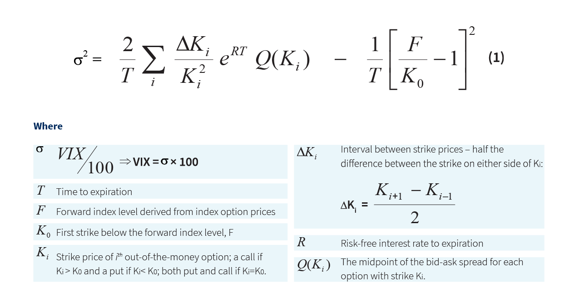
VIX
The VIX Index is a financial benchmark designed to be an up-to-the-minute market estimate of expected volatility of the S&P 500® I calculated by using the midpoint of real-time S&P 500® (SPX) option bid/ask quotes.
More specifically, the VIX Index is intended to provide an instantaneous measure of how much the market thinks the S&P 500 Index will fluctuate in the 30 days from the time of each tick of the VIX Index.

Slide 6
Merging the Data
Since there were many nontrading days I merged the sets to just the trading days.
All headline data from after the last trading day is merged into the next trading day.
An overall sentiment for each day was also found, although slowly, with Vader on the concatenated headlines of the day.
The idea is to use all of the previous trading day's headline and price data to predict the next day's close.
CLOSE
Positive
Negative
Neutral
Total
dayOfWeek
headlines
stocks
date
ave_vader
daily_sentiment
compound
overall_sentiment
Pos_minus_Neg
Pos_minus_Neg_pct
Neg_pct
summed_vader
sentiments
The final features of the dataset were:

Slide 7
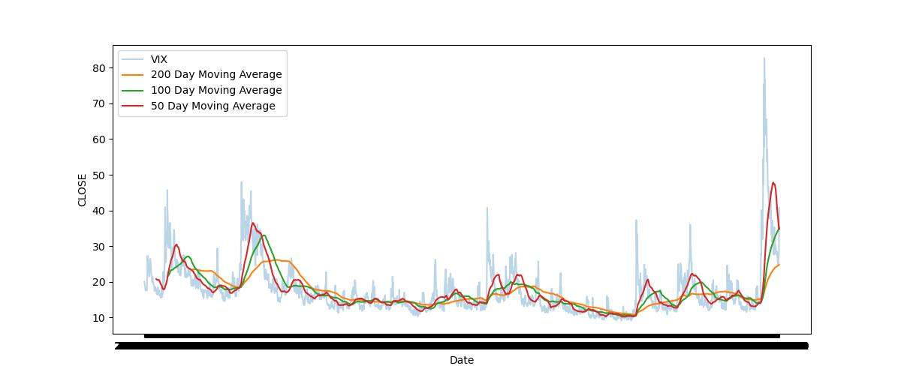
Time series EDA
The VIX is stationary and without seasonality.
Conveniently, the exogenous features also have extremely low p-values in the Ad-Fuller test indicating that they are also stationary and can be used in the SARIMAX model.

Slide 8
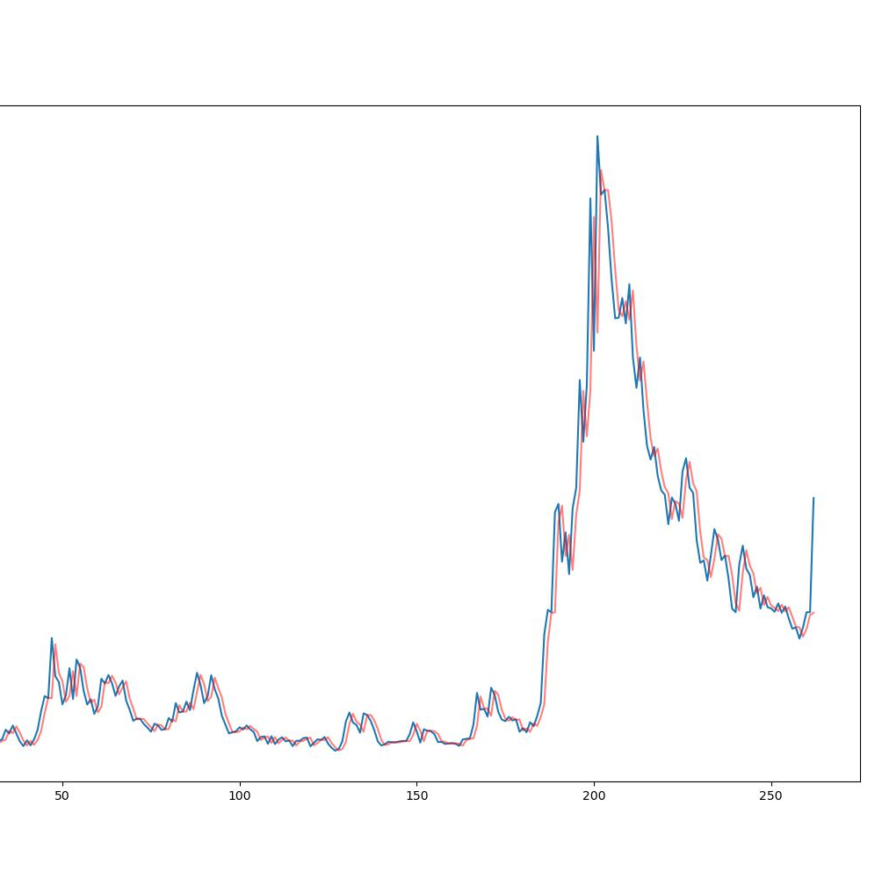
Baseline Model
RMSE: 3.297
Notice that the graphs are ‘out of phase’ indicating the poor directional prediction and that the big spike is Covid.
First, we find the best ARIMA model using a 90/10 split of the data with walk-forward validation on just over a year of unseen data (263 trading days)
ARIMA(1, 1, 0) slightly surpasses ARIMA(2, 2, 2) but has the advantage of being about twice as fast

Slide 9

Neural Networks
Gated Recurrent Units
Failed to make accurate walk-forward predictions.
Could not seem to foresee spikes.
Did not seem to improve with larger numbers of epochs.
Slowed down dramatically with larger numbers of neurons.
Did seem to at least predict the moving average reasonably well so it might work in a classification model for direction.
Long Short Term Memory
Had the same issues as GRU.
Could not match the baseline model in performance.
Was similarly extremely slow and computationally expensive.

Slide 10
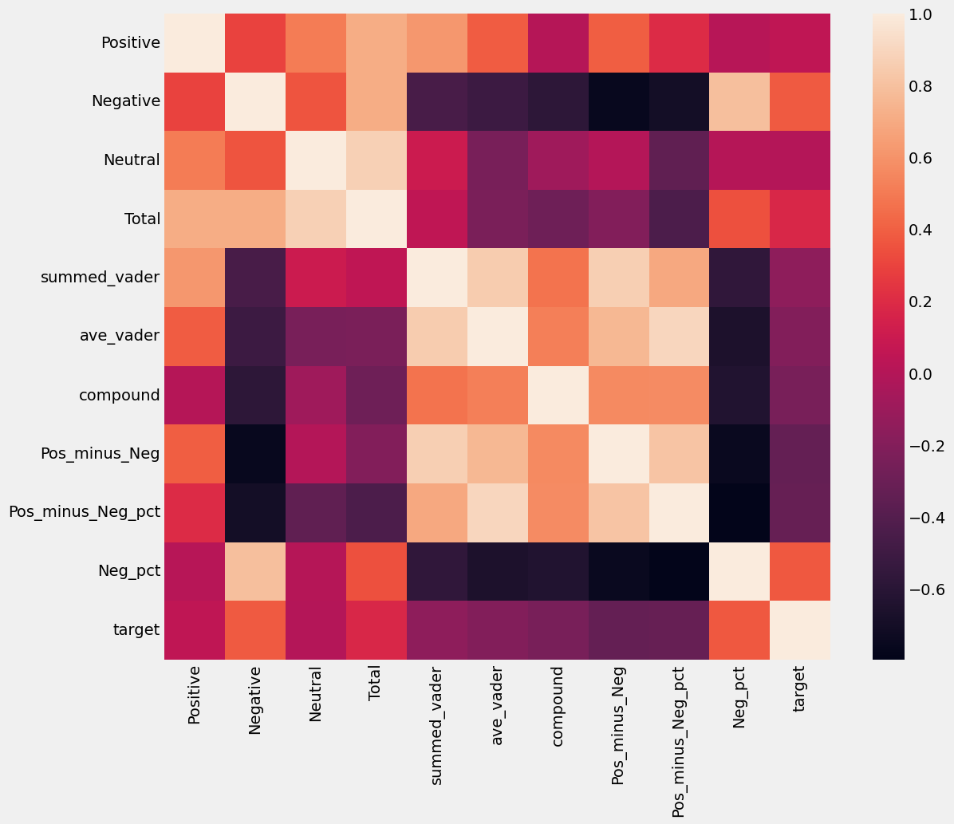
SARIMAX
The SARIMAX model is based on ARIMA(Autoregression Integrated Moving Average) but allow for seasonality, the S, and exogenous features, the X.
Wanting to not have the initial model run for days , I first used the most important features in a linear regression model “Neg_pct” and “Pos_minus_Neg_pct” as the only features in the exogenous set.
This model showed modest improvement to a RMSE of 3.164 in a similar walk forward validation.

Slide 11
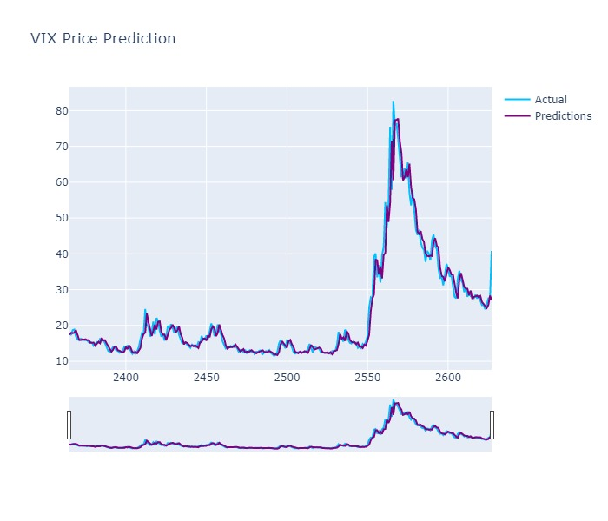
SARIMAX
Using just 2 features makes a small gain with speed loss less than an order of magnitude.
The full exogenous features set explodes under encoding of categorical variables with many categories, using up massive computational resources.

Slide 12
Adding more features
Knowing that SARIMAX could work in a reasonable time add in all the stationary numerical features and apply scaling in preprocessing.
Of the categorical features more care is taken and only 3 features are used: daily_sentiment and overall_sentiment which have 3 categories each and DayofWeek with 5.
This model again showed improvement over the last one with a RMSE of 3.042 an improvement over the baseline model of just over 9%.

Slide 13

What went right
There was a noticeable improvement in the SARIMAX vs ARIMA model which can be viewed at least as a proof of concept.
The cleaned dataset is ready for additional feature engineering.
Some initial groups of stocks and indices were completed and appeared to show promise in initial testing.

Slide 14

What went wrong
The methodology did not work well at predicting directional signals. A classification approach is needed instead.
Other time-series models may have been more effective such as GARCH or adaptive learning.
The categorical features needed to be refined in the exogenous set for faster running times.
The RMSE of 3 is still too high considering the average value in the mid-teens.

